Slide 1

WIPRO NGA Program – C++ Programming || Linux System Programming Batch
Capstone Project presentation-
Project Title - Railway Ticket Booking System
Present by Deepanshu Malviya

Slide 2

OVERVIEW
It is a simple implementation of a train booking system using socket programming in C. The system consists of a server and a client, which communicate with each other using TCP sockets.
The server listens for incoming connections on port 8080 and responds to client requests. The client connects to the server and sends requests to book train tickets. The server processes the requests and sends responses back to the client. The system allows users to book train tickets by selecting a train number and specifying the number of seats to book.
The server validates the input and sends a confirmation message to the client if the booking is successful. The code demonstrates the use of socket programming, TCP connections, and basic error handling in a networked application.

Slide 3
INTRODUCTION
In today's digital age, online booking systems have become an essential part of our daily lives. Whether it's booking a flight, a hotel room, or a train ticket, online booking systems provide a convenient and efficient way to plan our travels. In this project, we aim to design and implement a simple train booking system using socket programming in C.
The system will allow users to book train tickets online, providing a user-friendly interface and efficient communication between the client and server. The goal of this project is to demonstrate the use of socket programming in a real-world application, while also providing a basic understanding of how online booking systems work. By the end of this project, we will have a fully functional train booking system that allows users to book train tickets with ease.

Slide 4
SCOPE
-Design and implementation of a server-side application that listens for incoming connections and responds to client requests
-Design and implementation of a client-side application that connects to the server and sends requests to book train tickets
-Development of a user-friendly interface for the client-side application to input train booking details
-Implementation of basic error handling and validation for user input
Testing and debugging of the system to ensure correct functionality

Slide 5
APPLICATION TOOL AND TECHNOLOGY
TECHNOLOGY:
C
Socket
TOOLS:
Visual Studio Code
Text Editor
Terminal/Console

Slide 6
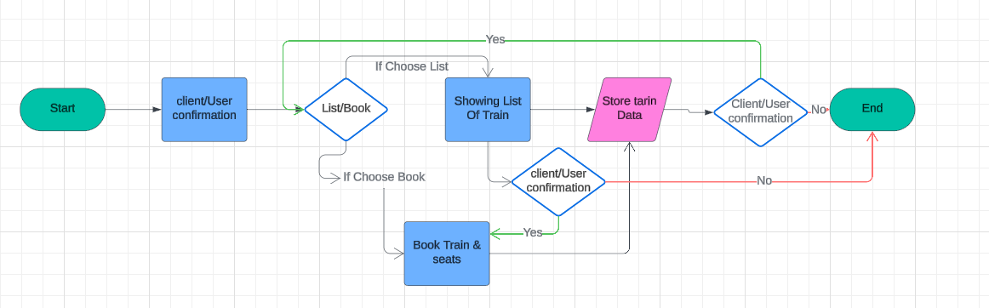
SYSTEM FLOW

Slide 7
Modules
There are two main module used in this project :
1. Server Module
2. Client Module
Server-Side Components:
Server Program: Handles incoming requests from clients, retrieves train data, processes booking requests, and sends responses back to clients.
Train Data Repository: Acts as a data access layer for train data, retrieving and storing train data in the database.
Client-Side Components:
Client Program: Creates a socket, connects to the server, sends user requests, and receives responses from the server.
User Interface: Provides a user-friendly interface for users to interact with the system, handling user input and displaying output.

Slide 8
LIST OF FUNCTION USED SERVER SIDE
init_trains(): Initializes the array of trains with their names and available seats.
list_trains(int client_sock): Sends a list of trains with their available seats to the client.
book_seats(int client_sock, int train_id, int num_seats): Books seats on a specified train and sends a response to the client.
handle_client(void *arg): Handles incoming client connections, receives commands, and sends responses.
main(): The main function that sets up the server, listens for incoming connections, and creates threads to handle clients.

Slide 9
LIST OF FUNCTION USED IN CLIENT SIDE
send_message(int sock, const char *message): Sends a message to the server through the socket.
receive_message(int sock, char *buffer): Receives a message from the server through the socket and stores it in the buffer.
print_prompt(const char *buffer): Prints a prompt to the user based on the received message from the server.
main(): The main function of the client program, which establishes a connection to the server, sends and receives messages, and handles user input.

Slide 10
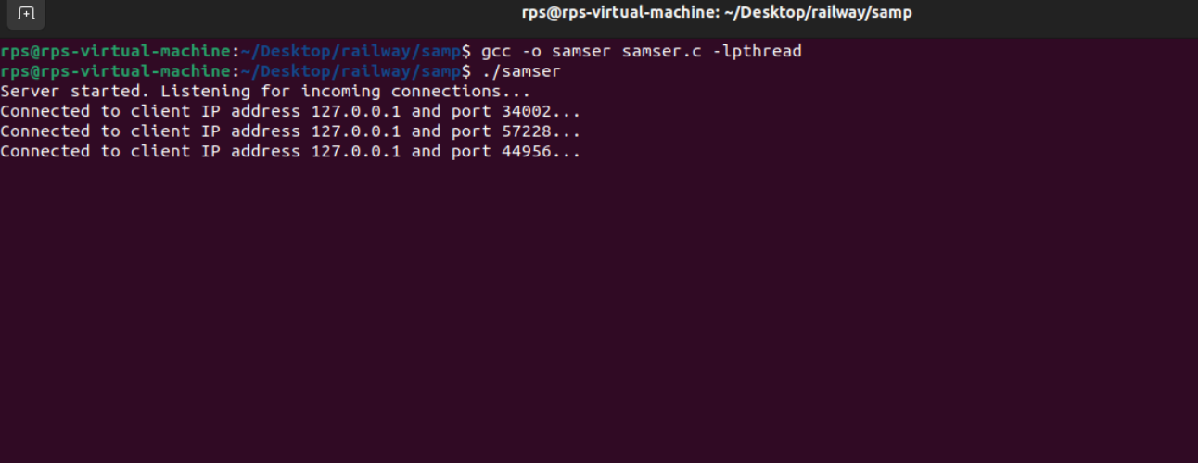
SERVER SIDE OUTPUT

Slide 11
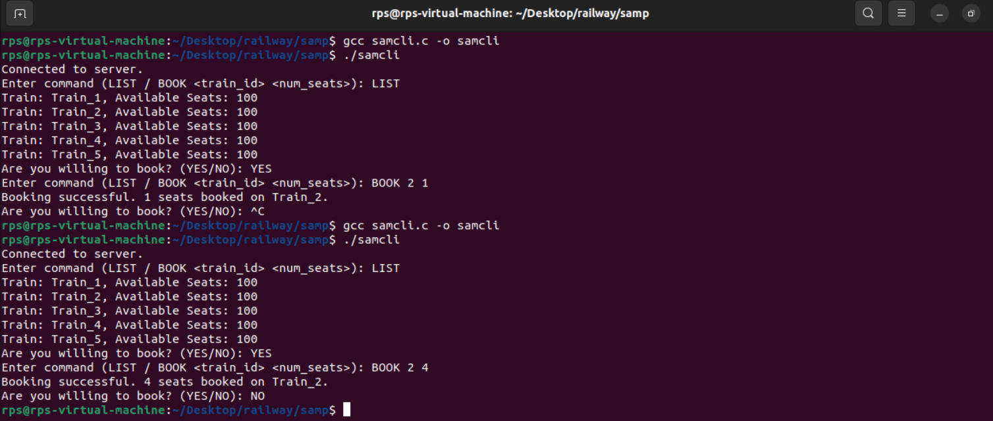
CLIENT SIDE OUTPUT

Slide 12
FUTURE ENHANCEMENT
User Authentication: Add login system and secure user credentials.
Expanded Train Info: Add more train details and filtering options.
Payment Gateway: Integrate online payment processing.
Advanced Booking: Allow multiple seat bookings, seat selection, and special requests.
Real-time Updates: Push real-time train schedule and availability updates to users.
Mobile App: Develop a mobile app for on-the-go bookings and access.
Improved UX: Enhance user interface and add features like autocomplete.
Integration: Integrate with other transportation systems and services.
Analytics: Collect and analyze user data to optimize the system.
Security and Scalability: Enhance security measures and optimize for scalability.

Slide 13
CONCLUSION
The Train Booking System project has successfully developed a functional and user-friendly online platform for booking train tickets. The system provides a convenient, efficient, and cost-effective solution for users. With a robust architecture and user-centric design, the system is poised to become a leading platform for online train ticket bookings, with opportunities for future enhancements and expansions.

